Slide 1


Slide 2


Problem statement
Credit Card Fraud Prevention
CARDING is a form of credit card
fraud in which a stolen credit card is used.
Carding typically involves the holder of
the stolen card purchasing store-branded gift cards, which can then be sold to others for a fair amount or used to purchase other goods that can be sold for cash.
Global card Fraud Losses Reach $16.31billion and is foreseen to exceed $35 billion by 2020.

Slide 3
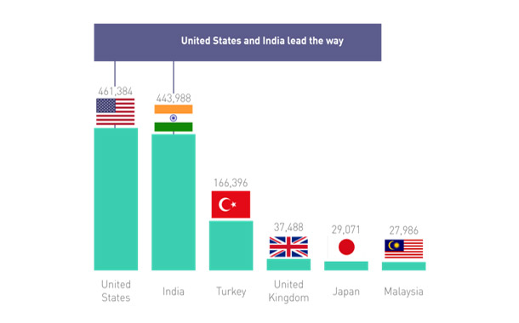
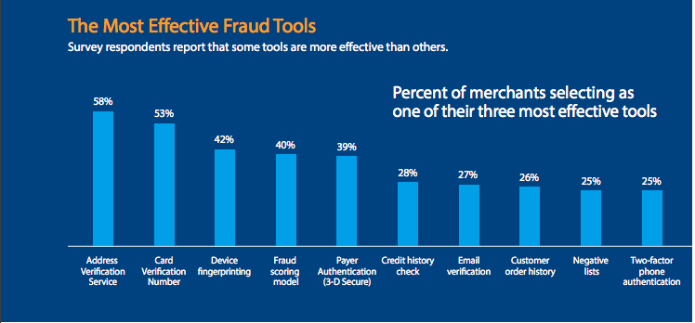
Significance of Problem
COVID-19 related spear phishing attacks increased by an alarming 667% between the end of February and March 23, 2020.
The below stats show the methods and number of carders,estimated, India alone has an estimated credit card fraud of $20 billion in the year 2019 .

Slide 4
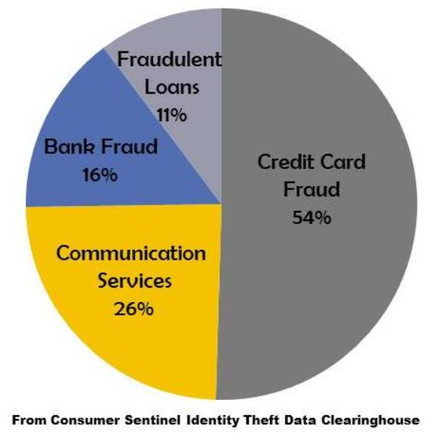
Fraud occurring without physical credit card is now 81% more likely than point-of-sale fraud according to Javelin Strategy.
Scammers use skimmers on point-of-sale systems to get your information and use it to make transactions.
India currently holds 2nd position in Credit Card and Debit Card frauds and have recorded highest number of frauds in a single year.
Sometimes due to less help from the police and due to high amount of such cases, the credit card owners may flee or commit suicide causing loss to both the bank and family members.

Slide 5


Slide 6



Solution
Existing Solutions
ADDRESS VERIFICATION SYSTEM
VELOCITY CHECKS
Our Solution : 'Card Pay'
It is a mobile application which Authenticates Users before transaction using AI Techniques, ensuring safety.
Use Cases:
Our Solution Helps to Prevent B2B or B2C Fraudulent Transactions.
Prevents Carding Attacks and losses due to it.

Slide 7

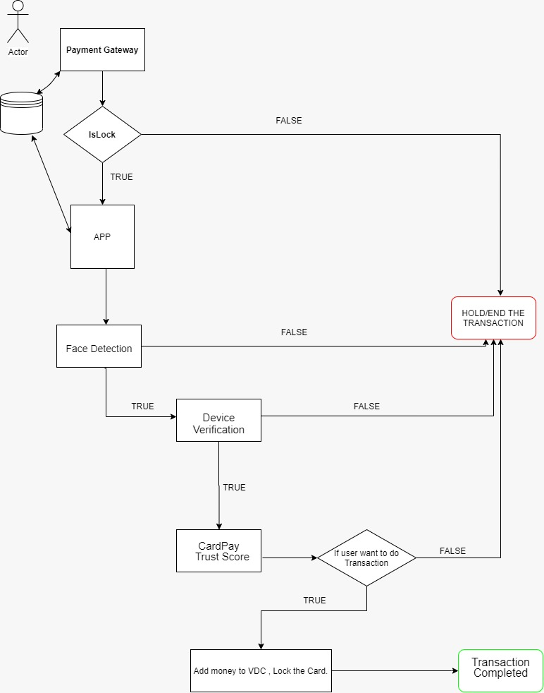
Workflow
Face Authentication is the only step to be performed by the user. Remaining steps run in the background.

Slide 8

Workflow Description
User Needs to register through application using his face and physical Credit Card.
The User will have to upload his PAN card and other basic details.
User can also add trusted faces/voices into the respective account.

Slide 9






Tech Stack
Android App (React Native)
AI (Face Recognition, OpenCV)
Python
Cloud Storage (Firebase )
Cloud Computing (GCP VM, AWS EC2 Instances)
Web Development (Flask, Node.js, HTML, Bootstrap, JavaScript)
AR/VR Chatbot (Amazon Sumerian)

Slide 10


Value Proposition
Uniqueness
Face Authentication for Card Transactions
CardPay Trust Score
Lock/Unlock Credit Cards
Card Pay Trust Score
Comfortable Application at Fingertips
24*7 Chat Support
User-friendly Application

Slide 11

Integrations & Future Scope
Card Pay as Payment Gateway
Card Pay API (Lock/Unlock)

Slide 12
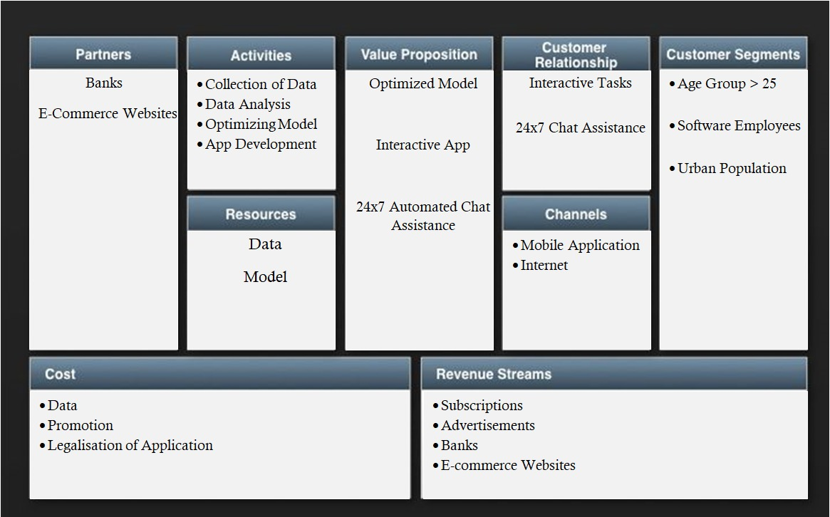
Business Model Canvas

Slide 13

Team
We believe security is not expensive, it is priceless
Use CardPay and Make Safer Transactions
Abhimanya Vuchuru abhimanya25111999@gmail.com
Rajeshwar Shivanathri rohithshivanathri@gmail.com
Rahul Thumula rahul.thumula@gmail.com
Sai Prakash Mandhadi saiprakashreddy14@gmail.com
Saadia Hassan saadiahassan786@gmail.com
Tharun Kumar Tallapalli kumartharun435@gmail.com
Thank You

